Slide 1
The CDC 8512 Microprocessor
Dr. Charles R. Severance
online.dr-chuck.com

Slide 2
Outline
Our two-instruction "CPU" - What is missing?
Instruction decoding and control
Real CPUs
The CDC8512 – inspired by the CDC 6500
Emulators – JavaScript – Old video Games at archive.org
Reading: Evolution of CPU Architecture
Reading: Intel 4004 – Back to the beginning

Slide 3
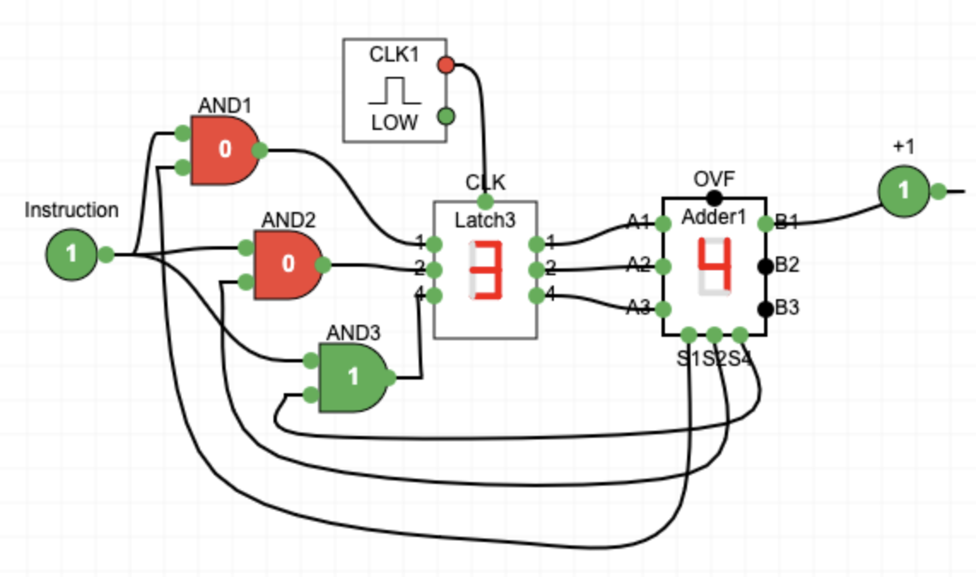
What is missing?
The instructions are not being read from memory.
It is like there is a switch on the front of the computer and it chooses between the two instructions
We want a flexible sequence of many combinations of instruction sequences(a.k.a. Software)

Slide 4

What
Next?
Generic
Computer
Software
Input
and Output
Devices
Central
Processing
Unit
Secondary
Memory
01001001
00111001
Main
Memory
Python for Everybody
Chapter 1
Slide 19
Machine
Language
Notes:
This slide is a block diagram of a computer showing a central processing unit connected to main memory. Software is loaded into the main memory. The software can also interact with input / output devices and secondary memory for long-term storage.

Slide 5
Fetch-Decode-Execute-Cycle
CPU
ALU
Data
Registers
Program Counter (PC) Register – Address of the next machine code instruction
Current Instruction Register (CIR)
The decoder looks at the bits of the CIR and using gates activates the correct ALU Element and register
The Clock causes the logic when to compute and when to copy results back to the register
PC
CIR
Decoder
Instructions
Cache / Memory
https://en.wikipedia.org/wiki/Binary_decoder

Slide 6
Machine Language Instructions
As part of the documentation for a CPU, we are given the bit patterns of the machine code for each of its instructions
There is usually a symbolic language that translates to machine language (assembler)
Assembly Language | Binary | Description
ZERO reg | 01000rrr | Set register to zero
CMPZ reg | 01001rrr | Compare register to zero
INC reg | 01010rrr | Increment register by 1
DEC reg | 01011rrr | Decrement register by 1

Slide 7
Let's learn Base-16 (Hexadecimal)
Base 16 is easy to convert to bits and much less verbose than Base-2

Slide 8
Recall Base-2
Base–2 to Base-10 for numbers less than 8
A.k.a. 3-bit numbers
Base-10 | Base-2
0 | 0
1 | 1
2 | 10
3 | 11
4 | 100
5 | 101
6 | 110
7 | 111
4s 2s 1s
1 1 0 = 6

Slide 9
The first problem with Base-16
Base-10 | Base-2 | Base-16
0 | 0 | 0
1 | 1 | 1
2 | 10 | 2
3 | 11 | 3
4 | 100 | 4
5 | 101 | 5
6 | 110 | 6
7 | 111 | 7
8 | 1000 | 8
9 | 1001 | 9
10 | 1010 | ✊
11 | 1011 | ☝️
12 | 1100 | ✌️
13 | 1101 | 🤟
14 | 1110 | 🍀
15 | 1111 | 🖐
We only have 0-9 and we need to be able to represent 0-15 in a single base-16 digit
Thankfully we have emoji's
10 ✊
11 ☝️
12 ✌️
13 🤟 (also Rock on!)
14 🍀
15 🖐

Slide 10
No emojis in 1940 😭📅😭
Base-10 | Base-2 | Base-16
0 | 0 | 0
1 | 1 | 1
2 | 10 | 2
3 | 11 | 3
4 | 100 | 4
5 | 101 | 5
6 | 110 | 6
7 | 111 | 7
8 | 1000 | 8
9 | 1001 | 9
10 | 1010 | A
11 | 1011 | B
12 | 1100 | C
13 | 1101 | D
14 | 1110 | E
15 | 1111 | F
We only have 0-9 as numbers and we need to be able to represent 0-15 in a single base-16 digit
So we used A-F to represent 10-15 for base-16 numbers

Slide 11
Base-10 and Base-16 (Hexadecimal) numbers
Need a cheat sheet
Base-10
123₁₀ = 1 x 10² + 2 x 10¹ + 3 * 10⁰
= 1 x 100 + 2 * 10 + 3 * 1 = 123₁₀
Base-16
7B₁₆ = 7 * 16¹ + 11 * 16⁰ =
= 112 + 11 = 123₁₀
Base-10 | Base-16
10 | A
11 | B
12 | C
13 | D
14 | E
15 | F

Slide 12
Base-16 to/from Base-2
Base-10 | Base-2 | Base-16
0 | 0 | 0
1 | 1 | 1
2 | 10 | 2
3 | 11 | 3
4 | 100 | 4
5 | 101 | 5
6 | 110 | 6
7 | 111 | 7
8 | 1000 | 8
9 | 1001 | 9
10 | 1010 | A
11 | 1011 | B
12 | 1100 | C
13 | 1101 | D
14 | 1110 | E
15 | 1111 | F
Since 2 and 16 are even powers of 2, each Base-16 represents exactly four base-2 digits so we can convert digit by digit
7B ₁₆
0111 1011 ₂
A2 ₁₆
1010 0010 ₂
Hex is just more succinct Base-2

Slide 13
Keep it simple for now
Base-10 | Base-2 | Base-16
0 | 0 | 0
1 | 1 | 1
2 | 10 | 2
3 | 11 | 3
4 | 100 | 4
5 | 101 | 5
6 | 110 | 6
7 | 111 | 7
8 | 1000 | 8
9 | 1001 | 9
10 | 1010 | A
11 | 1011 | B
12 | 1100 | C
13 | 1101 | D
14 | 1110 | E
15 | 1111 | F
Go through base-2 if it helps
8s 4s 2s 1s
1 0 1 0 = 10 = A
1 0 0 0 = 8 = 8
1 1 1 1 = 15 = F

Slide 14
Chuck's Not-so-quick Guide to Base-16
F₁₆ = 15₁₀ = 1111₂ (Easy one less than 16)
E₁₆ = 14₁₀ = 1110₂ (one less than 15)
A₁₆ = 10₁₀ = 1010₂ (8+2)
B₁₆ = 11₁₀ = 1010₂ (8+2+1)
C₁₆ = 😕 🧠 🤟 = 8+3 = 1011₂
D₁₆ = 😕 🤔 ⬆️ ⬇️ 🧠 📝 😠
AI: What is a good way to be able to do hex to base 2 conversions in your head?

Slide 15
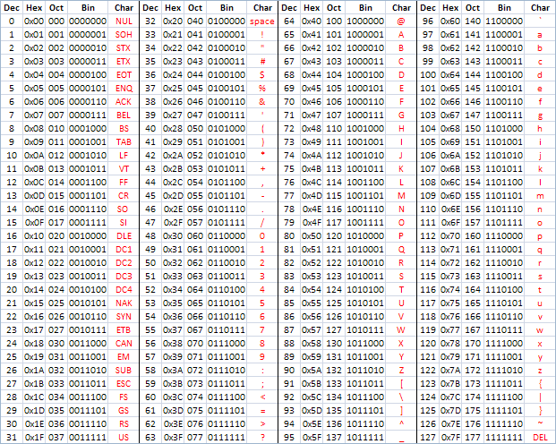
ASCII – 8 Bits
ASCII Characters are 8-bits and can be nicely represented with two hex digits (a.k.a. nibbles)
American Standard Code for Information Interchange
https://en.wikipedia.org/wiki/ASCII
http://www.catonmat.net/download/ascii-cheat-sheet.png

Slide 16
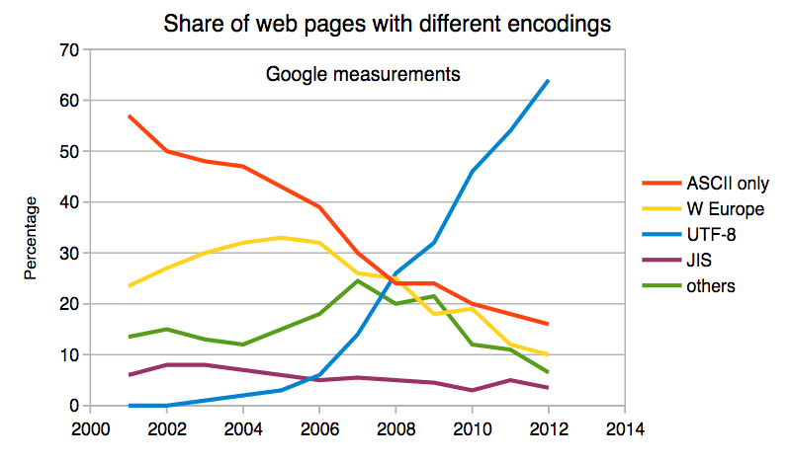
Multi-Byte Characters (a quick aside…)
To represent the wide range of characters computers must handle we represent characters with more than one byte
UTF-16 – Fixed length - Two bytes
UTF-32 – Fixed Length - Four Bytes
UTF-8 – 1-4 bytes
- Upwards compatible with ASCII
- Automatic detection between ASCII and UTF-8
- UTF-8 is recommended practice for encoding data to be exchanged between systems
https://en.wikipedia.org/wiki/UTF-8

Slide 17
Lets Design a CPU
The CDC8512 is designed to be understandable

Slide 18
Why wouldn't we use a real CPU?
Intel X86 – Introduced in 1978
Focused on Desktop computers
Includes AMD
ARM – Introduced in 1985
Focused on early cell phones
Core Instruction Set + Extensions
Intel 4004
Quite complex because it needed to be a complete solution
CD8512 takes many design cues from Intel 4004
Real CPUs are quite intricate because over time they added new instructions and kept the old ones for compatibility.

Slide 19
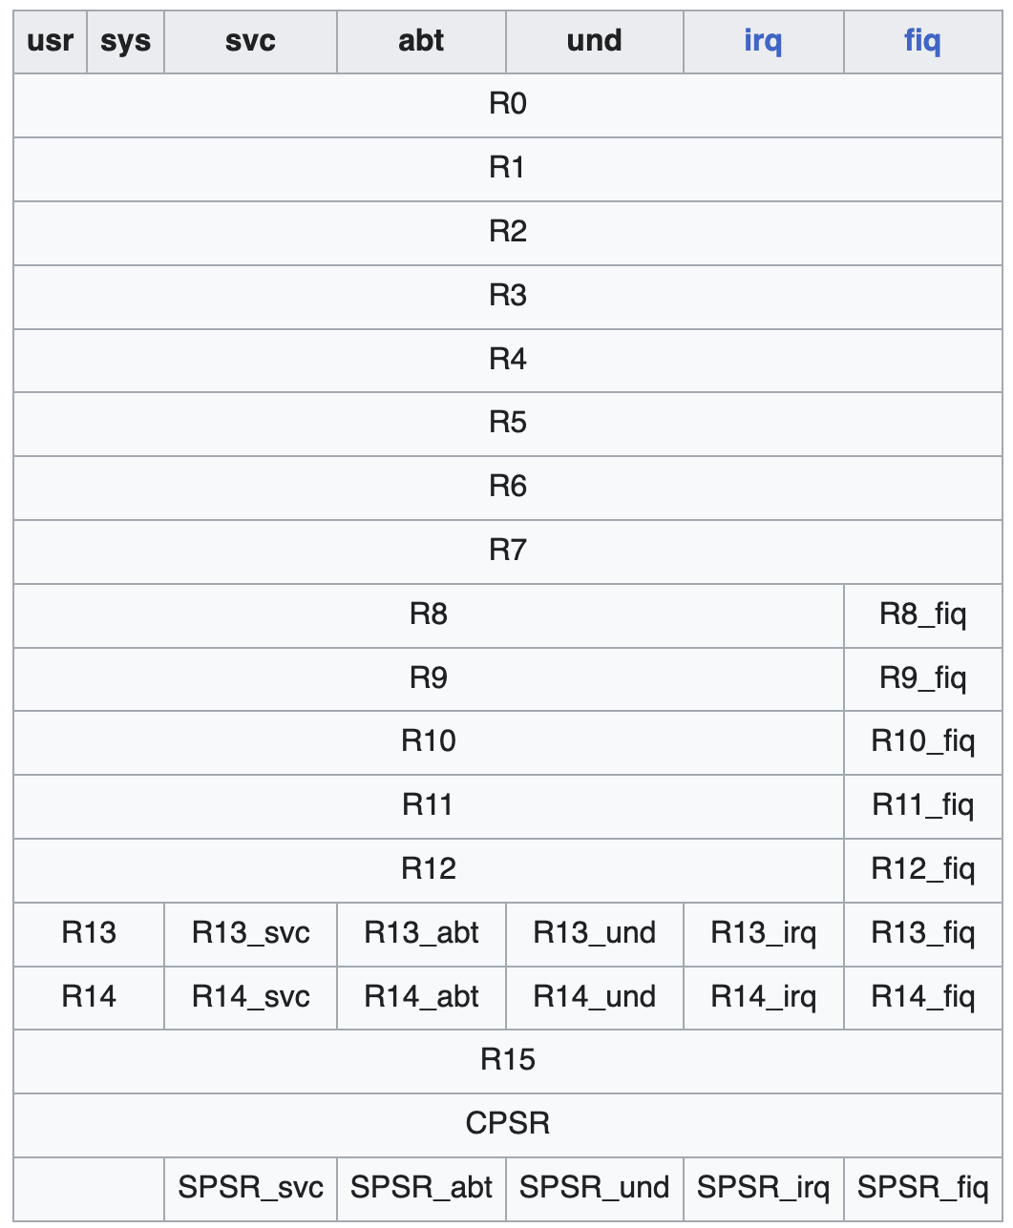
ARM Assembly
.global _start
_start:
MOV R0, #3 @ Load 3 into R0
MOV R1, #4 @ Load 4 into R1
ADD R0, R0, R1 @ R0 = R0 + R1 (3 + 4 = 7)
MOV R7, #1 @ syscall: exit
SWI 0 @ exit with code in R0 (7)

Slide 20
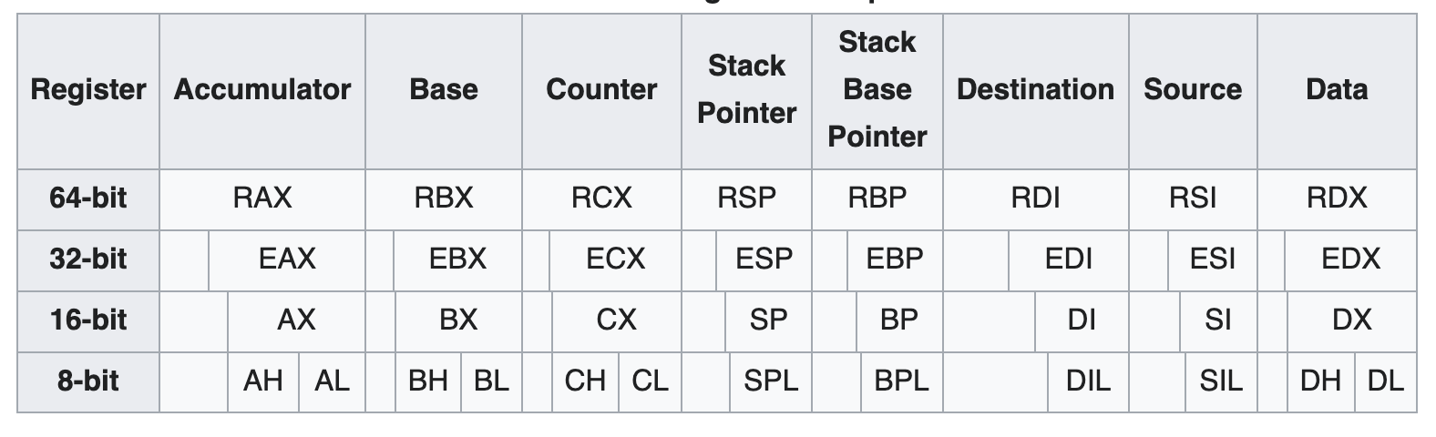
Intel X86 Assembly
global _start
_start:
mov eax, 3 ; Load 3 into eax
mov ebx, 4 ; Load 4 into ebx
add eax, ebx ; eax = eax + ebx (3 + 4 = 7)
mov ebx, eax ; exit code = sum (7)
mov eax, 1 ; syscall number for exit
int 0x80 ; make syscall

Slide 21
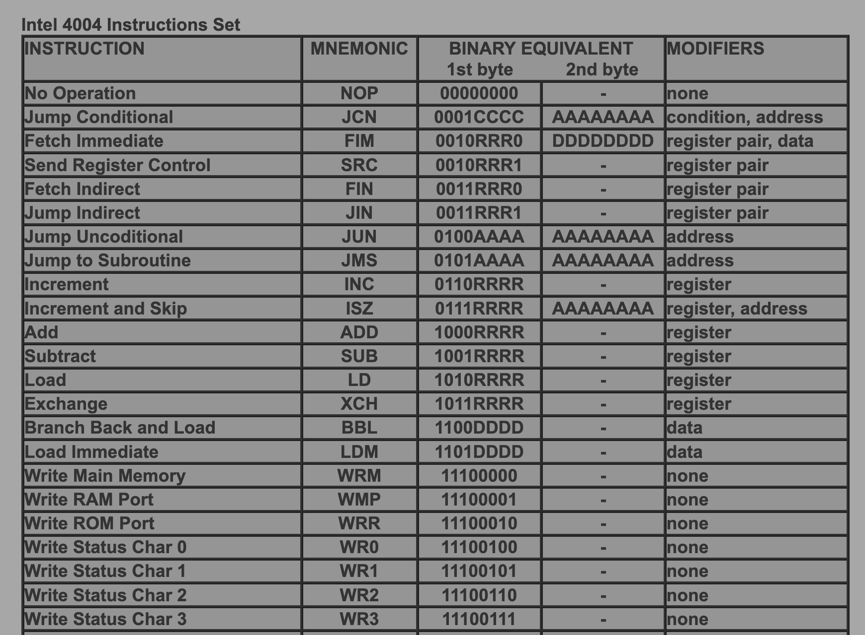
Intel 4004
http://e4004.szyc.org/iset.html
This is about 5% of the Intel 4004 instruction set documentation
CDC8512 is i4004-like
8-Bit instructions
16-Bit instructions with immediate operands
CDC8512 is much simpler
No keyboard input
No display, etc…
…
Notes:
If you look closely there is a typo in the i4004 documentation ☺

Slide 22
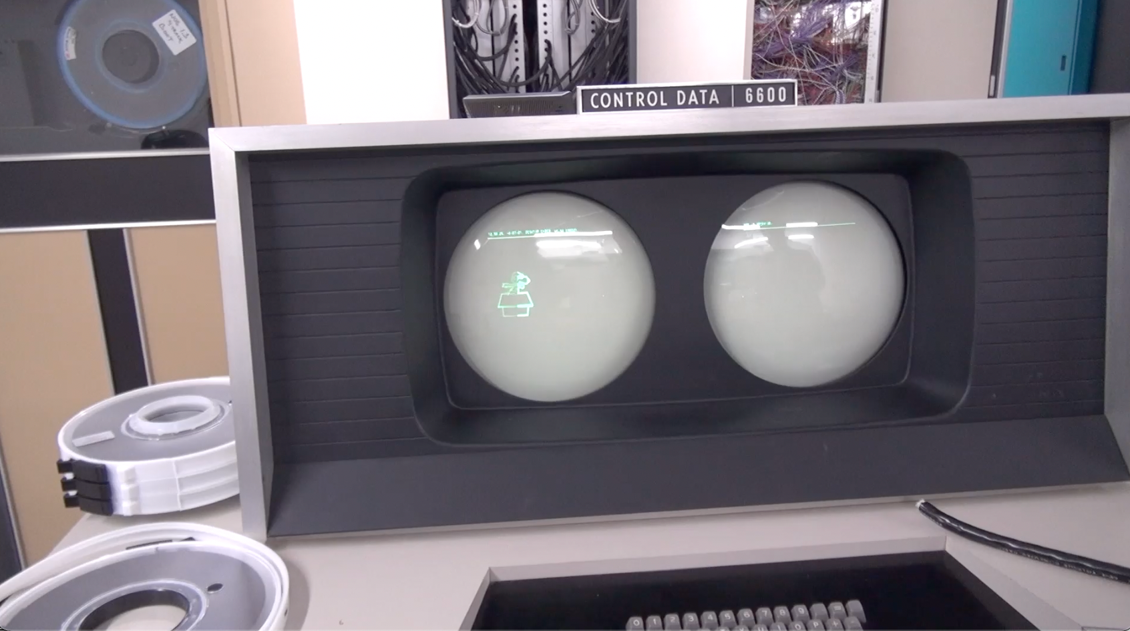
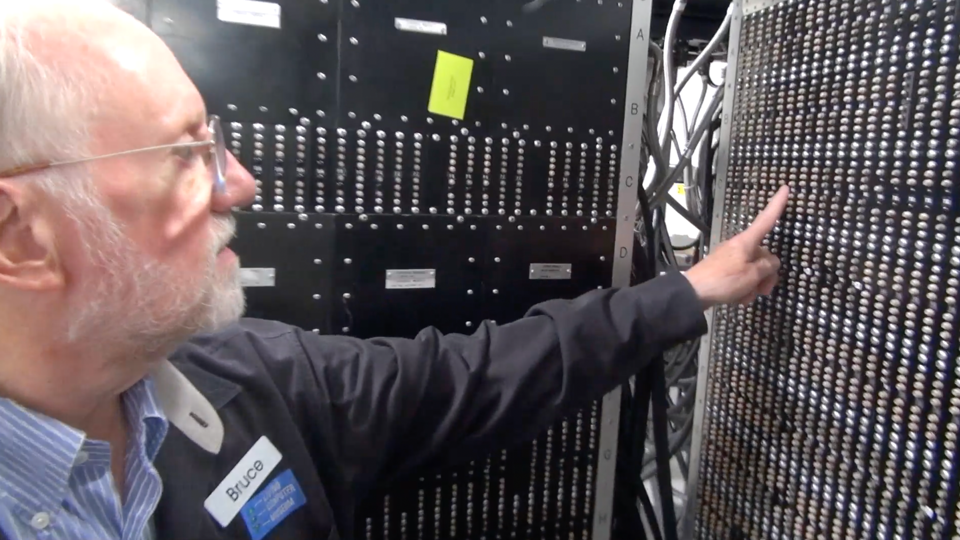
CDC 8512 - Inspired by CDC 6500 (and i4004)
Control Data Corporation
Mid 1960’s – mid-1970’s
Dr. Chuck’s first computer
FORTRAN
Assembly Language
https://en.wikipedia.org/wiki/CDC_6000_series#Central_processor

Slide 23
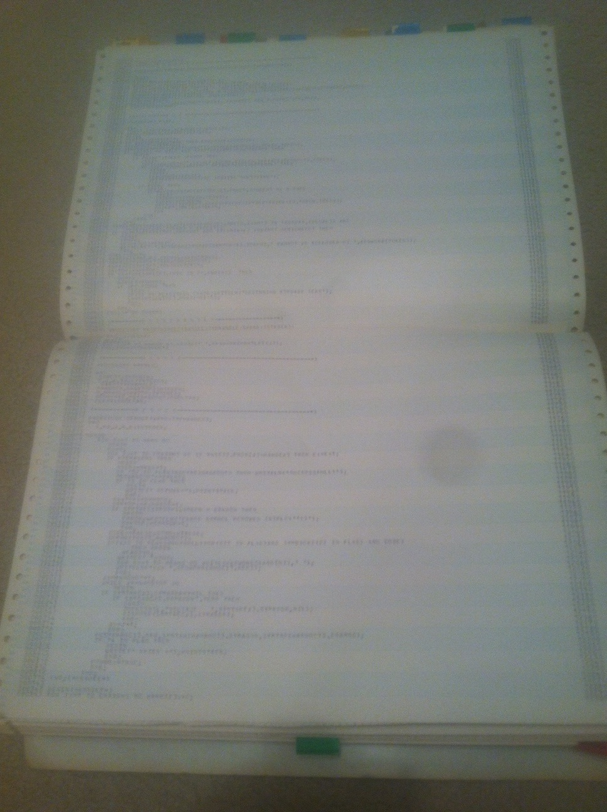
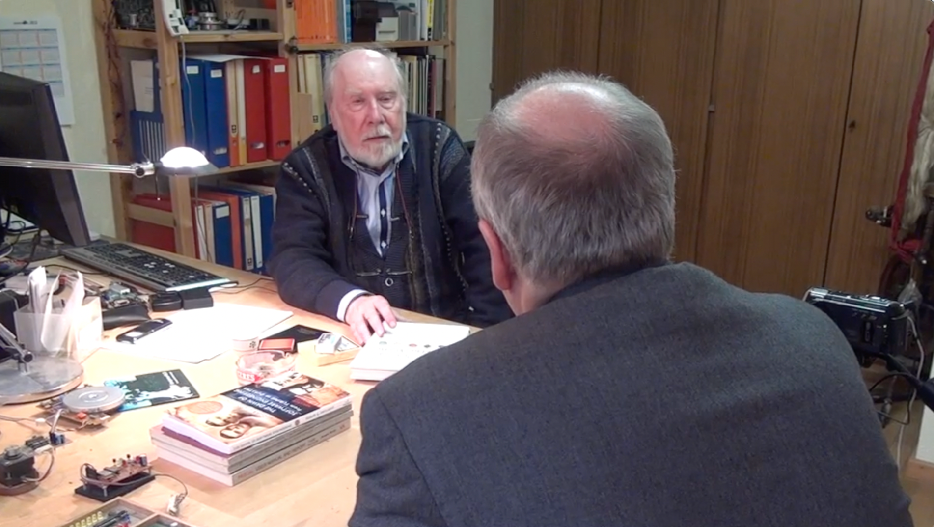
CDC 8512 - Inspired by CDC 6500
Control Data Corporation
Mid 1960’s – mid-1970’s
Dr. Chuck’s first computer
FORTRAN
Assembly Language
Pascal
https://en.wikipedia.org/wiki/CDC_6000_series#Central_processor

Slide 24
About the CDC6500
60 bit words – Integer and floating point formats
6 bit characters - upper case only
Two kinds of data registers - A0-A7 – Address and X0-X7 Operands
To load from memory you put the address in A1-A5 and the data from memory is loaded into the corresponding X1-X5
To store into memory you put the data in X6 or X7 and Set the corresponding A6 or A7 to the location where you want the memory stored

Slide 25
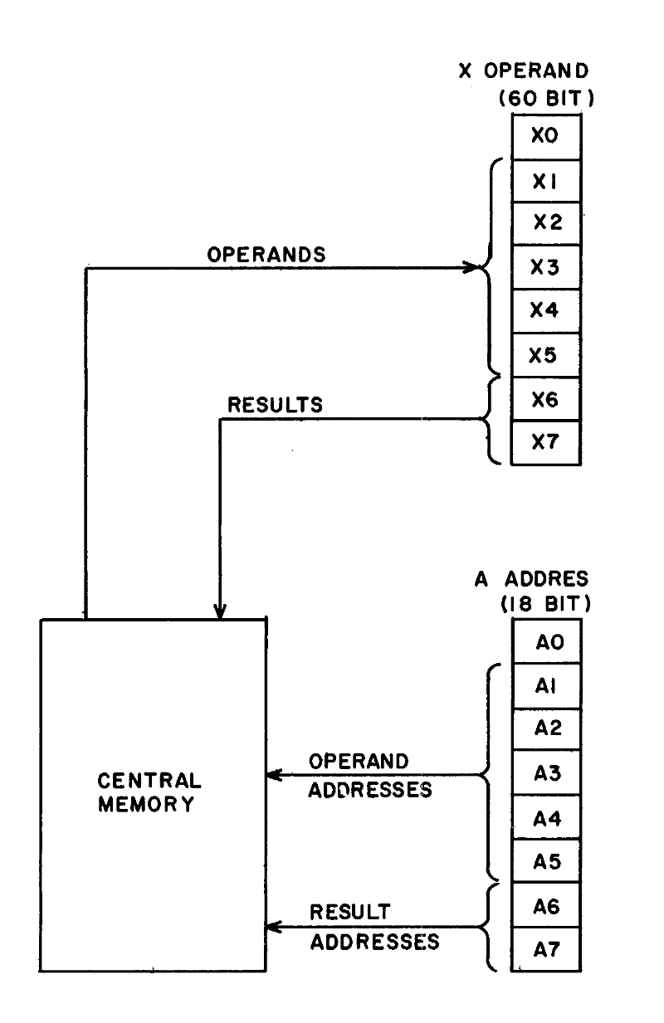
To provide a more compact symbolic language, the 24 operating registers are identified by letters and numbers:
A = Address Register (A0, A1 .. A7)
B = increment register (B0, B1 … B7)
X = operand register (X0, X1 … X7)
The operand registers hold operands and results for servicing the functional units. Five registers (X1-X5) hold read operands from Central Memory and two registers X6 – X7) hold results to be sent to Central Memory (Figure 3-2).
Operands and results transfer between memory and these registers as a result of placing a quantity into a corresponding address register (A1-A7).
-- Control Data 6400/6500/6660 Computer Systems Reference Manual
Figure 3.2
http://ygdes.com/CDC/60100000D_6600refMan_Feb67.pdf

Slide 26
About the CDC8512
8 bit words – Positive integers only (i.e. like a C char)
8 bit characters – ASCII (i.e. like a C char)
32 bytes of Instruction memory and 32 bytes of Data memory
Eight 8-bit registers (A0-A3) and (X0-X3)
When A0 is set it causes a load from Data[A0] into X0 to happen
When A1 is set it causes a load from Data[A1] into X1 to happen
When A2 is set it causes a store from X2 into Data[A2] to happen
When A3 is set it causes a store from X3 into Data[A3] to happen

Slide 27
The CDC8512 Architecture

Slide 28
CDC8512 Architecture
PC
CMP
Mode
A0
A1
A2
A3
0x00
<=>
0
0x00
0x00
0x00
0x00
X0
X1
X2
X3
PC – Program Counter
CMP – Result of most recent comparison
Mode – Error indicator
A and X registers shown in hex
Instruction memory shows in base-2 for easy decoding
Data memory shows in hex – will usually contain ASCII
0x00
0x00
0x00
0x00
What
Next?
Instruction Memory
Data Memory
0x00
01000110
0x00
0x00
0x01
01010110
0x01
0x00
0x02
01010110
0x02
0x00
0x03
01000010
0x03
0x00
0x04
00000000
0x04
0x00
0x05
00000000
0x05
0x00

Slide 29
Memory Architecture
PC
CMP
Mode
A0
A1
A2
A3
0x00
<=>
0
0x00
0x00
0x00
0x00
X0
X1
X2
X3
X0 / X1 are Load Registers
X2 / X3 are Store Registers
Setting A0 / A1 causes a load into X0 / X1
Setting A2 / A3 causes a store from X2 / X3
Data memory (255) holds values when we don't have enough registers
0x00
0x00
0x00
0x00
Instruction Memory
0x00
01000110
0x00
0x00
0x01
01010110
0x01
0x00
0x02
01010110
0x02
0x00
0x03
01000010
0x03
0x00
0x04
00000000
0x04
0x00
0x05
00000000
0x05
0x00

Slide 30
Programming the CDC8512
https://www.ca4e.com/tools/cdc8512/documentation.html
Assembly language is easier to read and translates directly to binary machine language
rrr | Register
000 | A0
001 | A1
010 | A2
011 | A3
100 | X0
101 | X1
110 | X2
111 | X3
Assembly | Binary | Description
ZERO reg | 01000rrr | Set register to zero
CMPZ reg | 01001rrr | Compare register to zero, set CMP flag
INC reg | 01010rrr | Increment register by 1
DEC reg | 01011rrr | Decrement register by 1

Slide 31
Our first Program
PC
CMP
Mode
A0
A1
A2
A3
0x00
<=>
0
0x00
0x00
0x00
0x00
X0
X1
X2
X3
A program
0x00
0x00
0x00
0x00
0x00
01000110
ZERO X2
INCR X2
INCR X2
Zero A2 (stores X2 in memory 0x00)
Halt
0x00
0x00
0x01
01010110
0x01
0x00
0x02
01010110
0x02
0x00
0x03
01000010
0x03
0x00
0x04
00000000
0x04
0x00
0x05
00000000
0x05
0x00
0x06
00000000
0x06
0x00

Slide 32
Our first Program
PC
CMP
Mode
A0
A1
A2
A3
0x00
<=>
0
0x00
0x00
0x00
0x00
X0
X1
X2
X3
A program
0x00
0x00
0x00
0x00
0x00
01000110
ZERO X2
INCR X2
INCR X2
Zero A2 (stores X2 in memory 0x00)
Halt
0x00
0x00
0x01
01010110
0x01
0x00
0x02
01010110
0x02
0x00
0x03
01000010
0x03
0x00
0x04
00000000
0x04
0x00
0x05
00000000
0x05
0x00
0x06
00000000
0x06
0x00

Slide 33
Our first Program
PC
CMP
Mode
A0
A1
A2
A3
0x01
<=>
0
0x00
0x00
0x00
0x00
X0
X1
X2
X3
A program
0x00
0x00
0x01
0x00
0x00
01000110
ZERO X2
INCR X2
INCR X2
Zero A2 (stores X2 in memory 0x00)
Halt
0x00
0x00
0x01
01010110
0x01
0x00
0x02
01010110
0x02
0x00
0x03
01000010
0x03
0x00
0x04
00000000
0x04
0x00
0x05
00000000
0x05
0x00
0x06
00000000
0x06
0x00

Slide 34
Our first Program
PC
CMP
Mode
A0
A1
A2
A3
0x02
<=>
0
0x00
0x00
0x00
0x00
X0
X1
X2
X3
A program
0x00
0x00
0x02
0x00
0x00
01000110
ZERO X2
INCR X2
INCR X2
Zero A2 (stores X2 in memory 0x00)
Halt
0x00
0x00
0x01
01010110
0x01
0x00
0x02
01010110
0x02
0x00
0x03
01000010
0x03
0x00
0x04
00000000
0x04
0x00
0x05
00000000
0x05
0x00
0x06
00000000
0x06
0x00

Slide 35
Our first Program
PC
CMP
Mode
A0
A1
A2
A3
0x03
<=>
0
0x00
0x00
0x00
0x00
X0
X1
X2
X3
A program
0x00
0x00
0x02
0x00
0x00
01000110
ZERO X2
INCR X2
INCR X2
Zero A2 (stores X2 in memory 0x00)
Halt
0x00
0x02
0x01
01010110
0x01
0x00
0x02
01010110
0x02
0x00
0x03
01000010
0x03
0x00
0x04
00000000
0x04
0x00
0x05
00000000
0x05
0x00
0x06
00000000
0x06
0x00

Slide 36
Our CPU from Logic, Gates, Transistors
Our CPU implements two instructions
Zero Register
Increment Register
There is no program counter (PC) because there is no instruction memory
But….

Slide 37
Our CPU from Logic, Gates, Transistors
Increment
Instruction
Our CPU implements two instructions
Zero Register
Increment Register
There is no program counter because there is no instruction memory
But….
Decode
Logic
Register

Slide 38
Looking closer
The difference between the ZERO and INCR instructions is one bit
If bit 5 is a zero, the register is zeroed
If bit five is a one, the register is incremented
0x00
01000110
ZERO X2
0x01
01010110
INCR X2

Slide 39
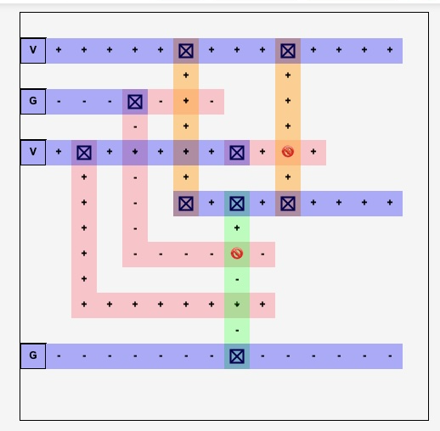
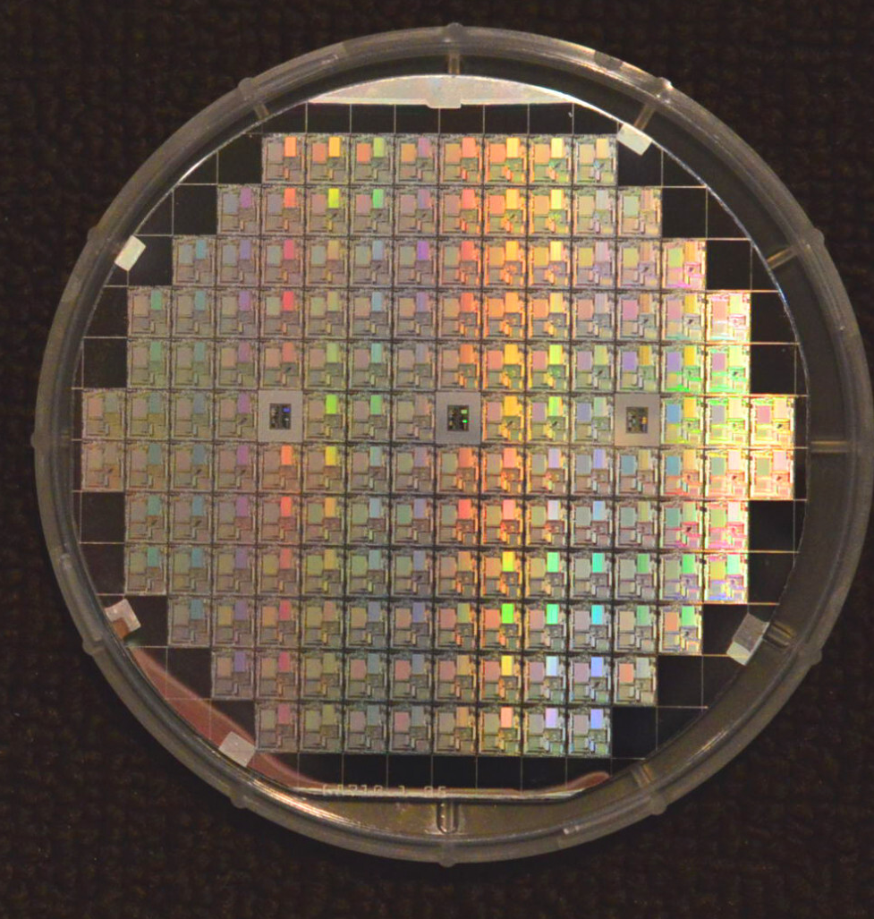
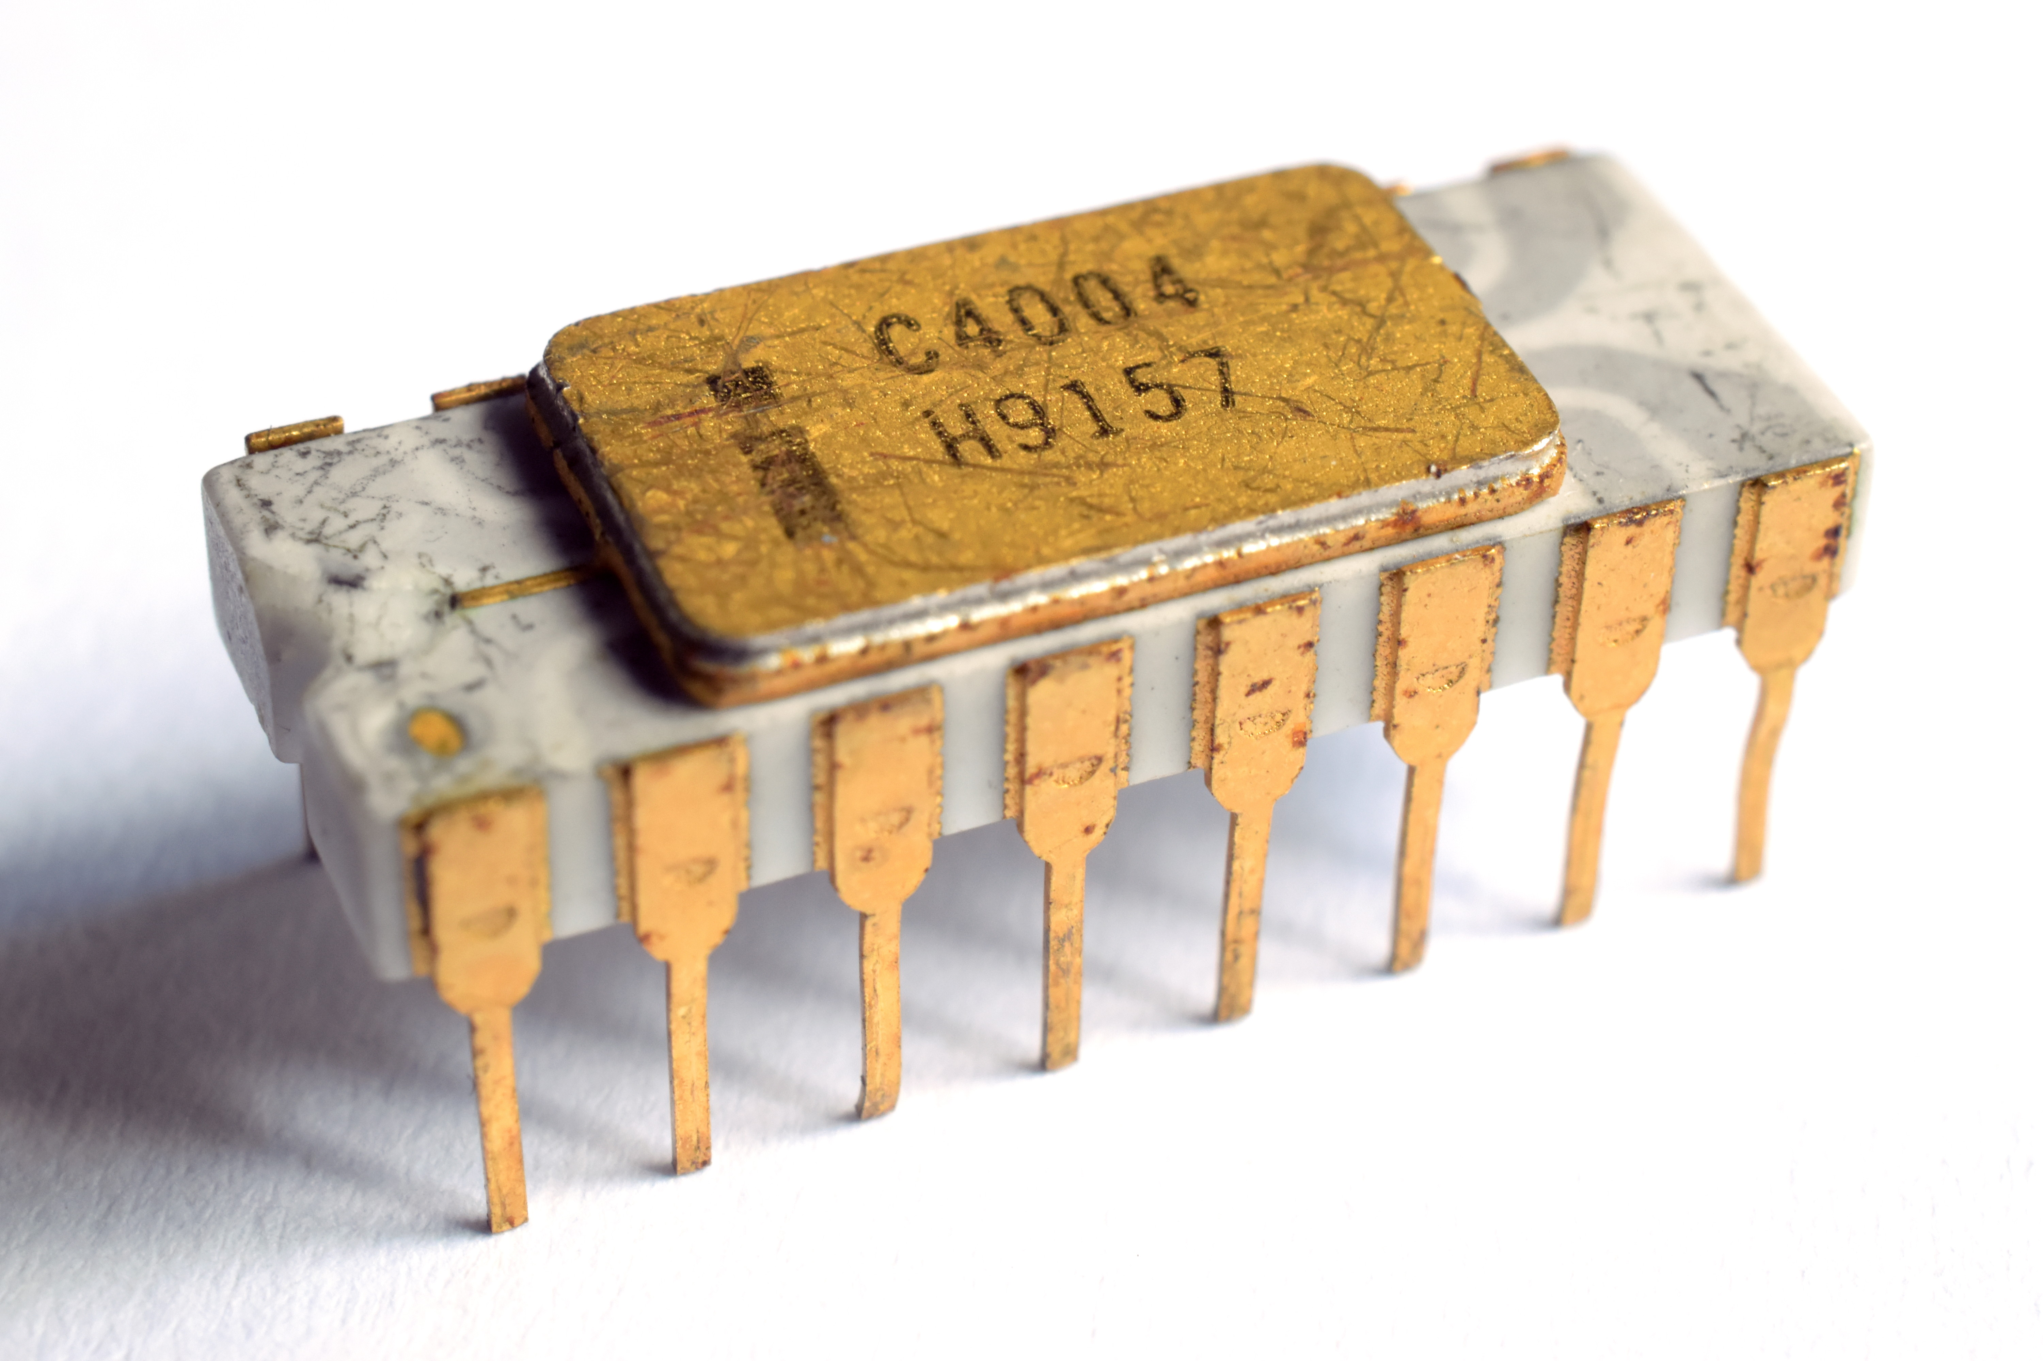
If you had time…
With what you know and and better design tools you could design a CDC8512
Logic
Memory
VLSI layout
Manufacture
It would probably be about as complex as the Intel 4004
The Intel 4004 is a better design ☺

Slide 40
Intel 4004

Slide 41
What is Programming? Python for Everybody www.py4e.com

Slide 42
What
Next?
Generic
Computer
Software
Input
and Output
Devices
Central
Processing
Unit
Secondary
Memory
01001001
00111001
Main
Memory
Python for Everybody
Chapter 1
Slide 19
Machine
Language
Notes:
This slide is a block diagram of a computer showing a central processing unit connected to main memory. Software is loaded into the main memory. The software can also interact with input / output devices and secondary memory for long-term storage.

Slide 43
Variables
A variable is a named place in the memory where a programmer can store data and later retrieve the data using the variable “name”
Programmers get to choose the names of the variables
You can change the contents of a variable in a later statement
12.2
x = 12.2
y = 14
x = 100
x
100
14
y

Slide 44

The True Story of Python Assignment Statements
Charles Severance
www.dj4e.com

Slide 45
Program Steps or Program Flow
Like a recipe or installation instructions, a program is a sequence of steps to be done in order.
Some steps are conditional - they may be skipped.
Sometimes a step or group of steps is to be repeated.
Sometimes we store a set of steps to be used over and over as needed several places throughout the program

Slide 46
Sequential Steps
x = 2
Program:
x = 2
print(x)
x = x + 2
print(x)
Output:
2
4
print(x)
x = x + 2
print(x)
When a program is running, it flows from one step to the next. As programmers, we set up “paths” for the program to follow.

Slide 47
Conditional Steps
x = 5
x < 10 ?
Yes
Program:
x = 5
if x < 10:
print('Smaller')
if x > 20:
print('Bigger')
print('Finis')
print('Smaller')
No
Output:
Smaller
Finis
x > 20 ?
Yes
print('Bigger')
No
print('Finis')

Slide 48
Repeated Steps
n = 5
No
n > 0 ?
Yes
Output:
5
4
3
2
1
Blastoff!
Program:
n = 5
while n > 0 :
print(n)
n = n – 1
print('Blastoff!')
print(n)
n = n -1
print('Blastoff')
Loops (repeated steps) have iteration variables that change each time through a loop.

Slide 49
Variables and Sequential Programming

Slide 50
Variables in Machine Language
There are no variables in machine language
There are no objects
There is no "dynamic memory allocation"
There are constants like 42, '*', and 123
We have a limited number of named registers in the CPU
There is one big array of memory locations
Memory is like one big array in C
Memory addresses are like pointers in C

Slide 51
CDC8512 Variables
PC
CMP
Mode
A0
A1
A2
A3
0x00
<=>
0
0x00
0x00
0x00
0x00
X0
X1
X2
X3
Address Registers (4) are for load / store addresses
X registers (4) are for data and computations and for load / store data
Data memory (255) holds variables when we want to reuse a register
0x00
0x00
0x00
0x00
Instruction Memory
Data Memory
0x00
00000000
0x00
0x00
0x01
00000000
0x01
0x00
0x02
00000000
0x02
0x00
0x03
00000000
0x03
0x00
0x04
00000000
0x04
0x00
0x05
00000000
0x05
0x00

Slide 52
Load / Store
PC
CMP
Mode
A0
A1
A2
A3
0x00
<=>
0
0x00
0x00
0x00
0x00
What
Next?
X0
X1
X2
X3
PC – Program Counter
CMP – Result of most recent comparison instruction
Mode – Error indicator
A and X registers shown in hex
Instruction memory is shown in base-2 for easy decoding
Data memory shows in hex – will usually contain ASCII
0x00
0x00
0x00
0x00
Instruction Memory
Data Memory
0x00
00000000
0x00
0x00
0x01
00000000
0x01
0x00
0x02
00000000
0x02
0x00
0x03
00000000
0x03
0x00
0x04
00000000
0x04
0x00
0x05
00000000
0x05
0x00

Slide 53
CDC8512 Architecture
PC
CMP
Mode
A0
A1
A2
A3
0x00
<=>
0
0x00
0x00
0x00
0x00
X0
X1
X2
X3
A program
0x00
0x00
0x00
0x00
0x00
10000110
Set register X2 to the next byte
The letter 'H'
Set A2 to 0 (Stores X2 at 0x00)
Set register X2 to the next byte
The letter 'i'
Add 1 to A2 (Stores X2 at 0x01)
Halt and Print
0x00
0x00
0x01
01001000
0x01
0x00
0x02
01000010
0x02
0x00
0x03
10000110
0x03
0x00
0x04
01101001
0x04
0x00
0x05
01010010
0x05
0x00
0x06
00000001
0x06
0x00

Slide 54
CDC8512 Architecture
PC
CMP
Mode
A0
A1
A2
A3
0x00
<=>
0
0x00
0x00
0x00
0x00
X0
X1
X2
X3
Start the program
Out first instruction is a two byte instruction
0x00 Sets X2 to the byte at 0x01
Advances the PC by 2
The byte at 0x01 is the ASCII letter for 'H' (0x68)
0x00
0x00
0x00
0x00
0x00
10000110
0x00
0x00
0x01
01001000
0x01
0x00
0x02
01000010
0x02
0x00
0x03
10000110
0x03
0x00
0x04
01101001
0x04
0x00
0x05
01010010
0x05
0x00
0x06
00000001
0x06
0x00

Slide 55
CDC8512 Architecture
PC
CMP
Mode
A0
A1
A2
A3
0x02
<=>
0
0x00
0x00
0x00
0x00
X0
X1
X2
X3
Start the program
Out first instruction is a two byte instruction
0x00 Sets X2 to the byte at 0x01
Advances the PC by 2
The byte at 0x01 is the ASCII letter for 'H' (0x68)
So 'H' is loaded into X2 and the PC is set to 0x02
0x00
0x00
0x48
0x00
0x00
10000110
0x00
0x00
0x01
01001000
0x01
0x00
0x02
01000010
0x02
0x00
0x03
10000110
0x03
0x00
0x04
01101001
0x04
0x00
0x05
01010010
0x05
0x00
0x06
00000001
0x06
0x00

Slide 56
CDC8512 Architecture
PC
CMP
Mode
A0
A1
A2
A3
0x02
<=>
0
0x00
0x00
0x00
0x00
X0
X1
X2
X3
We load the instruction at 0x02
Which sets A0 to 0 and as a side effect, stores the contents of X2 into data location 0x00
0x00
0x00
0x48
0x00
0x00
10000110
0x00
0x48
0x01
01001000
0x01
0x00
0x02
01000010
0x02
0x00
0x03
10000110
0x03
0x00
0x04
01101001
0x04
0x00
0x05
01010010
0x05
0x00
0x06
00000001
0x06
0x00

Slide 57
CDC8512 Architecture
PC
CMP
Mode
A0
A1
A2
A3
0x03
<=>
0
0x00
0x00
0x00
0x00
X0
X1
X2
X3
We load the instruction at 0x02
Which sets A0 to 0 and as a side effect, stores the contents of X2 into data location 0x00
Then the PC is updated to 0x03
0x00
0x00
0x48
0x00
0x00
10000110
0x00
0x48
0x01
01001000
0x01
0x00
0x02
01000010
0x02
0x00
0x03
10000110
0x03
0x00
0x04
01101001
0x04
0x00
0x05
01010010
0x05
0x00
0x06
00000001
0x06
0x00

Slide 58
CDC8512 Architecture
PC
CMP
Mode
A0
A1
A2
A3
0x03
<=>
0
0x00
0x00
0x00
0x00
X0
X1
X2
X3
The instruction at 0x03 is a two byte instruction
0x03 Sets X2 to the byte at 0x04
Advances the PC by 2
The byte at 0x04 is the ASCII letter for 'i' (0x89)
So 'i' is loaded into X2
0x00
0x00
0x69
0x00
0x00
10000110
0x00
0x48
0x01
01001000
0x01
0x00
0x02
01000010
0x02
0x00
0x03
10000110
0x03
0x00
0x04
01101001
0x04
0x00
0x05
01010010
0x05
0x00
0x06
00000001
0x06
0x00

Slide 59
CDC8512 Architecture
PC
CMP
Mode
A0
A1
A2
A3
0x05
<=>
0
0x00
0x00
0x00
0x00
X0
X1
X2
X3
The instruction at 0x03 is a two byte instruction
0x03 Sets X2 to the byte at 0x04
Advances the PC by 2
The byte at 0x04 is the ASCII letter for 'i' (0x89)
So 'i' is loaded into X2
And the PC is set to 0x05
0x00
0x00
0x69
0x00
0x00
10000110
0x00
0x48
0x01
01001000
0x01
0x00
0x02
01000010
0x02
0x00
0x03
10000110
0x03
0x00
0x04
01101001
0x04
0x00
0x05
01010010
0x05
0x00
0x06
00000001
0x06
0x00

Slide 60
CDC8512 Architecture
PC
CMP
Mode
A0
A1
A2
A3
0x05
<=>
0
0x00
0x00
0x01
0x00
X0
X1
X2
X3
We load the instruction at 0x05
Which adds 1 to A0 and as a side effect, stores the contents of X2 into data location 0x00
Then the PC is updated to 0x06
0x00
0x00
0x69
0x00
0x00
10000110
0x00
0x48
0x01
01001000
0x01
0x69
0x02
01000010
0x02
0x00
0x03
10000110
0x03
0x00
0x04
01101001
0x04
0x00
0x05
01010010
0x05
0x00
0x06
00000001
0x06
0x00

Slide 61
CDC8512 Architecture
PC
CMP
Mode
A0
A1
A2
A3
<=>
0
0x00
0x00
0x01
0x00
X0
X1
X2
X3
We load the instruction at 0x06
Which is a "Halt and Print" instruction
The memory contains a zero terminated string
0x68 0x89 0x00
From the ASCII table, our output is "Hi"
0x00
0x00
0x69
0x00
0x00
10000110
0x00
0x48
0x01
01001000
0x01
0x69
0x02
01000010
0x02
0x00
0x03
10000110
0x03
0x00
0x04
01101001
0x04
0x00
0x05
01010010
0x05
0x00
0x06
00000001
0x06
0x00

Slide 62
Review
PC
CMP
Mode
A0
A1
A2
A3
0x06
<=>
0
0x00
0x00
0x01
0x00
X0
X1
X2
X3
0x00
0x00
0x69
0x00
Hi
0x00
10000110
Set register X2 to the next byte
The letter 'H'
Set A2 to 0 (Stores X2 at 0x00)
Set register X2 to the next byte
The letter 'i'
Add 1 to A2 (Stores X2 at 0x01)
Halt and Print
0x00
0x48
0x01
01001000
0x01
0x69
0x02
01000010
0x02
0x00
0x03
10000110
0x03
0x00
0x04
01101001
0x04
0x00
0x05
01010010
0x05
0x00
0x06
00000001
0x06
0x00

Slide 63
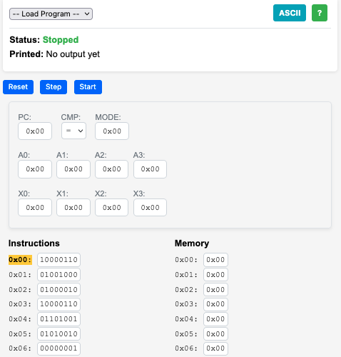
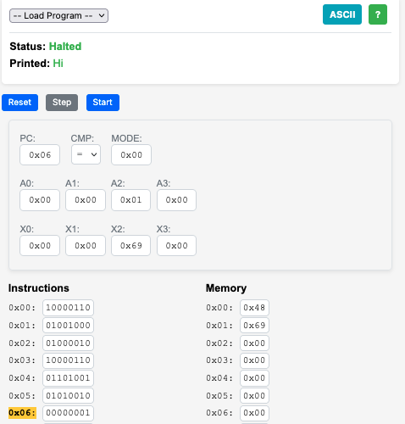
Hi

Slide 64
Comparison Register

Slide 65
Low level language
What is a jump instruction - there is no if-then-else
There is no for or while loops - there is only compare and conditionally jump

Slide 66
CDC 8512 – Instruction Set
https://www.ca4e.com/cdc8512/documentation.html

Slide 67
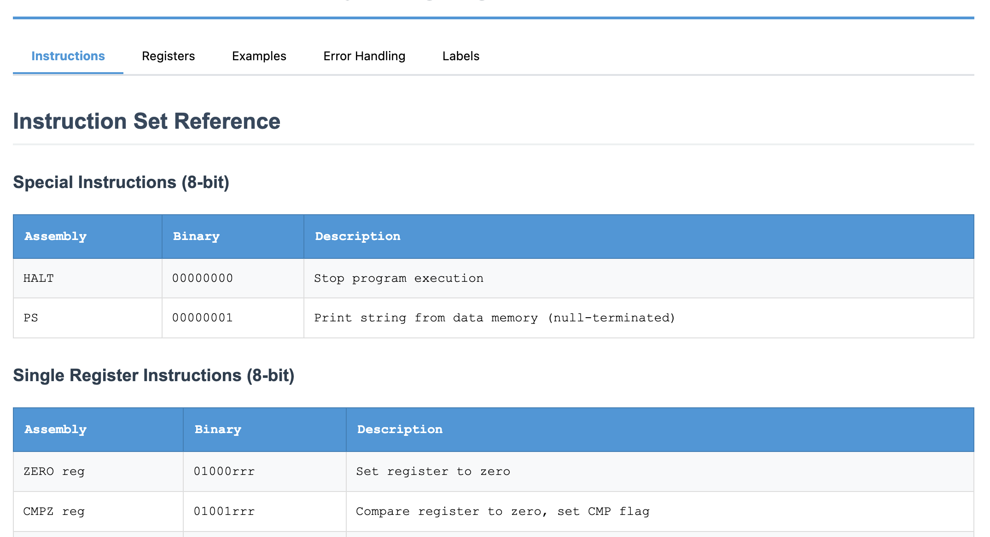
CDC8512 CPU Reference

Slide 68
Set a Register
SET X3, 'C' ; Set X3 to the value for ASCII C (67)
SET A3, 0 ; Set A3 to zero and store 'C' in data memory location 0x00
SET A1, 0 ; Set A1 to zero and load memory location 0x00 into X0
MOV X1, X3 ; Copy X3 to X1
SET A3, 0x01 ; Set A3 to 1 and store 'C' in data memory location 0x01
SET X3, 0x00 ; Set X3 to zero
SET A3, 0x02 ; Set A3 to 0x02 and store X3 into location 0x02
; Note constants can be decimal (0-255) hexadecimal (0x00-0xff) or a single
; ASCII character in single quotes 'a'

Slide 69
Register Arithmetic
; This will print: Hello
SET X3, 'H' ; Set X3 to the value for ASCII H
SET A3, 0 ; Set A3 to zero and store 'H' in data memory location 0x00
SET X3, 'e' ; Set X3 to 'e'
INC A3 ; Add 1 to A3 and store 'e' in location 0x01
SET X3, 'l' ; Set X3 to 'l'
ADD A3, 1 ; Add 1 to A3 and store 'l' in location 0x02
INC A3 ; Add 1 to A3 and store 'l' in location 0x03
ADD X3, 4 ; Add 4 to X3 so that it is now 'p'
DEC X3 ; Subtract 1 from X3 so that it is now 'o'
INC A3 ; Add 1 to A3 and store '0' in location 0x04
SET X3, 0 ; Set X3 to integer zero
INC A3 ; Add 1 to A3 and store integer 0 in location 0x05
PS ; Print memory starting at data address 0 as an
; ASCII string, stopping when a zero is encountered

Slide 70
Comparison and Jumps
JP 0x12 ; Set the PC (Program Counter) to an instruction address and
; continue execution at that address
CMP X3, 42 ; Compare a register to a constant and set comparison status
JE 0x12 ; Jump to the instruction address if comparison status is =
JG 0x12 ; Jump to the instruction address if comparison status is >
JL 0x12 ; Jump to the instruction address if comparison status is <

Slide 71
Miscellaneous Instructions
PS # Print data area starting at specified data address
# stopping when an integer 0 byte is encountered
HALT # Stop Execution

Slide 72
Summary
SX3 A3 # Copy a register to another
SX3 42 # Set a register to an 8-bit
INC A1 # Add 1 to a register
DEC X3 # Subtract 1 from a register
ADD X1, 42 # Add a constant to a register
SUB X3, 42 # Subtract a constant from a register
JP 0x12 # Jump to a label
CMP X3, 42 # Compare a register to a constant and set comparison status
JE 0x12 # Jump to the address if CMP was equal
JG 0x12 # Jump to the address if CMP was >
JL 0x12 # Jump to the address if CMP was <
PS # Print data area as character string
DI # Dump Instruction area in hex 16 per line
DD # Dump data area in hex 16 per
HALT # Stop Execution

Slide 73
CDC 8512 – Machine Language
(a.k.a. the zeros and ones of programming)

Slide 74
CDC 8512 - Assembly / Machine Code
SET X2, 'H'
ZERO A2
SET X2, 'i'
INC A2
PS
HALT
10000110
01001000 'H'
01000010
10000110
01101001 'i'
01010010
00000001
00000000

Slide 75
Single Register 8-bit Instruction
Zero Register
Register
ZERO A2
0
1
0
0
0
0
1
0
Op Code
Register
Number
0 = A register
1 = X register

Slide 76
Set Register to Constant (16-bit instruction)
Set Register
SET X2,'H'
1
0
0
0
0
1
1
0
0
1
0
0
1
0
0
0
Op Code
ASCII for 'H'
Register
Number
0 = A register
1 = X register

Slide 77
Single Register 8-Bit Instruction
INC A2 # Increment A2
Decrement Register
Register
0
1
0
1
0
0
1
0
Op Code
Register
Number
0 = A register
1 = X register

Slide 78
Print and Halt Instructions
0
0
0
0
0
0
0
1
PS # Print Memory
HALT # Stop the CPU
0
0
0
0
0
0
0
0

Slide 79
Two Register Instruction
Register
Copy
Destination
Register
Source
Register
MV A1,X3 ; Copy A1 to X3
1
1
0
0
1
1
1
1
0 = A register
1 = X register
Register
Number
Register
Number
0 = A register
1 = X register

Slide 80
CDC8512 Emulator in JavaScript
// 5-bit patterns (bits 7-3)
else if ((instruction >> 3) === 0x08) { // 01000xxx - ZERO
const register = instruction & 0x07;
const regName = this.getRegisterName(register);
this.cpu[regName] = 0;
// CDC 6500 load/store architecture:
if (regName === 'a0') {
this.cpu.x0 = this.cpu.memory[this.cpu.a0];
} else if (regName === 'a1') {
this.cpu.x1 = this.cpu.memory[this.cpu.a1];
} else if (regName === 'a2') {
this.cpu.memory[this.cpu.a2] = this.cpu.x2;
} else if (regName === 'a3') {
this.cpu.memory[this.cpu.a3] = this.cpu.x3;
}
pcIncrement = 1;
}

Slide 81
Emulators for Fun

Slide 82
Building Emulators for Historical CPUs
It is not all that difficult to build an emulator for an older (simpler) CPU
Modern processors on our phones and computers are so fast that JavaScript in a browser can emulate historical machine code faster than the original hardware
The computer / phone / browser graphics are also far better
And it can be great fun

Slide 83

Archive.org: Internet Arcade

Slide 84
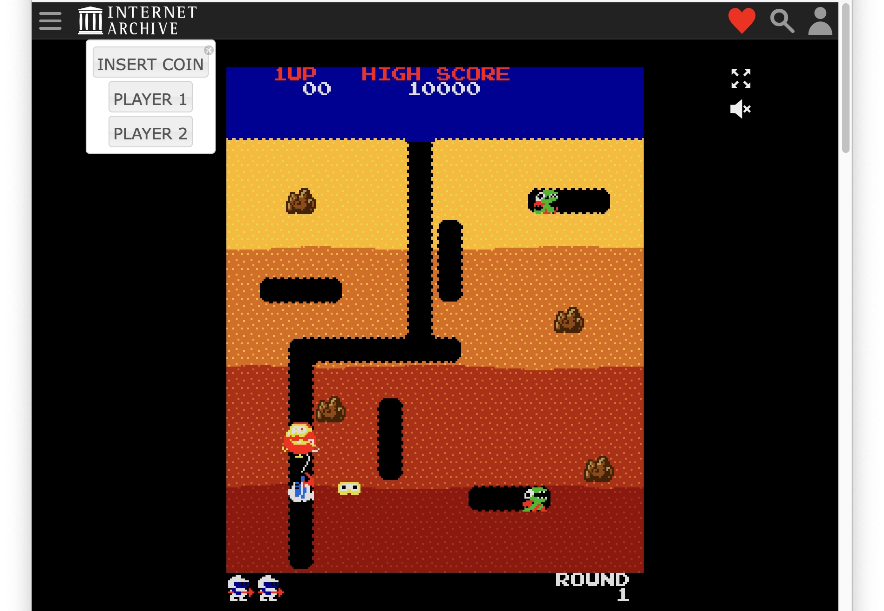
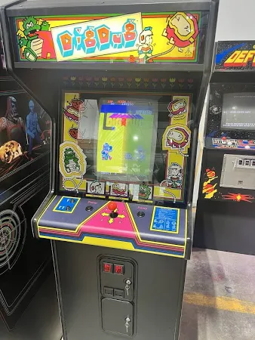
Game: Dig Dug

Slide 85
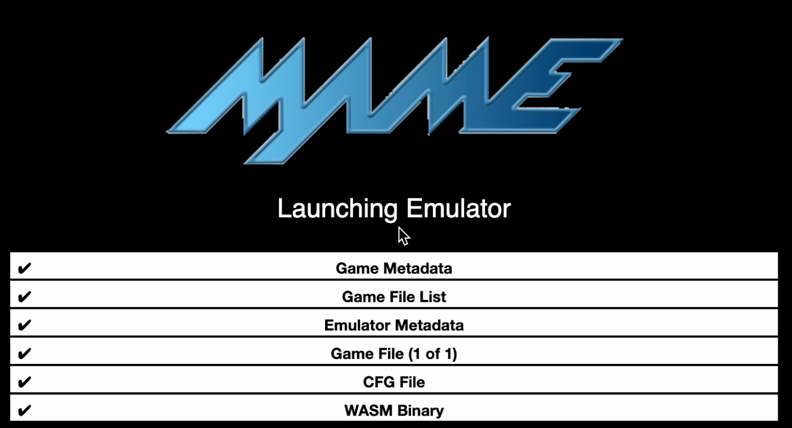
Dig Dug Startup – JSMAME Emulator

Slide 86
CPU Evolution
Why we invented our own super simple processor to learn.

Slide 87
Apple Computer Processors over time
MOS 6502 - Apple II – 1977 - 1993
Motorola MC68000 – Macintosh 1984-1994
IBM PowerPC – Macintosh 1994 – 2006
Intel x86 – Macintosh (2006-2020)
Samsung ARM – iPhone (2007-2009)
Apple ARM – iPhone (2010-Present)
Apple ARM – Macintosh (2020-Present)
Apple currently redesigns their CPUs based on workload over time – Image Processing / Audio / Video / Gaming / Artificial Intelligence

Slide 88
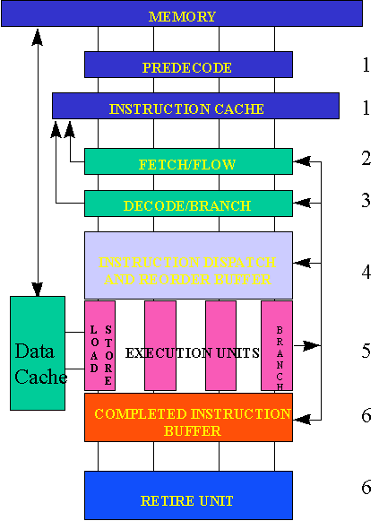
Reading: Post-Risc Architecture
https://cse.msu.edu/~enbody/postrisc/postrisc2.htm

Slide 89

Reading: Intel 4004
https://www.4004.com/
http://e4004.szyc.org/
http://e4004.szyc.org/iset.html
http://e4004.szyc.org/emu/

Slide 90
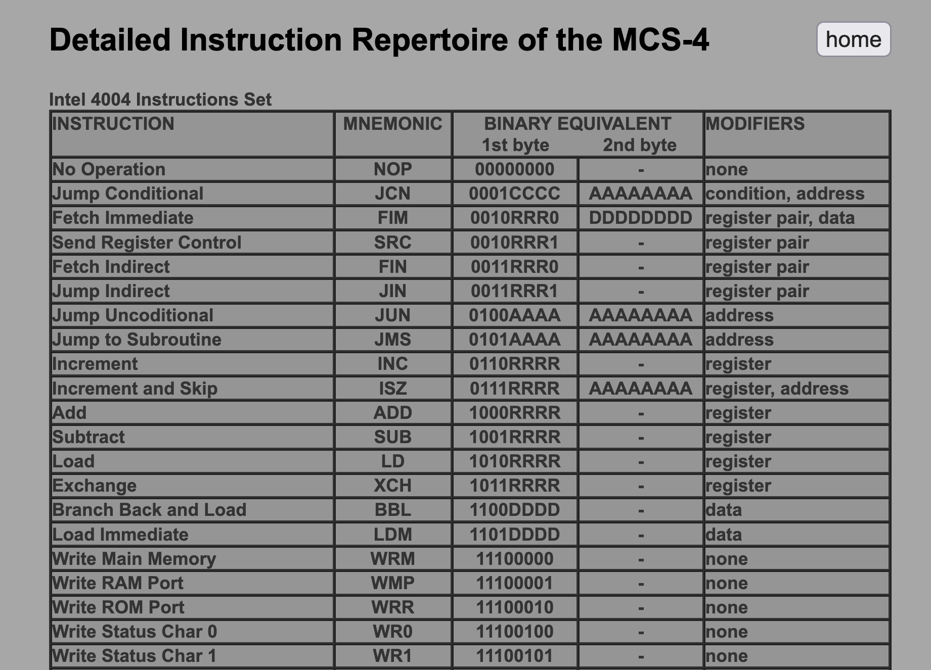
http://e4004.szyc.org/iset.html

Slide 91
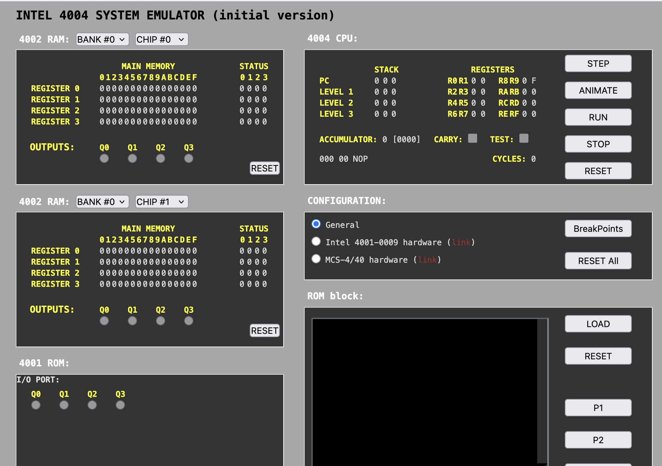
http://e4004.szyc.org/emu/

Slide 92
WASM – Web Assembly
There is a machine language emulator built into browsers called Web Assembly
For a wide range of software, compiling to WASM and running in JavaScript is enough
WASM is a different syntax than most Assembly languages – but it still compiles to a binary-machine code
C Programming for Everybody (www.cc4e.com) C Playground compiles C to WASM and then runs the WASM in the user's browser

Slide 93
WASM Hello World
;; Hello World WASM Example
(module
(import "console" "log" (func $log (param i32 i32)))
(memory 1)
(data (i32.const 0) "Hello, World!")
(func $main (result i32)
(call $log (i32.const 0) (i32.const 13))
(i32.const 42)
)
(export "main" (func $main))
)
00000000: 00 61 73 6d 01 00 00 00 01 0a 02 60 02 7f 7f 00 |.asm.......`....|
00000010: 60 00 01 7f 02 0f 01 07 63 6f 6e 73 6f 6c 65 03 |`.......console.|
00000020: 6c 6f 67 00 00 03 02 01 01 05 03 01 00 01 07 11 |log.............|
00000030: 02 06 6d 65 6d 6f 72 79 02 00 04 6d 61 69 6e 00 |..memory...main.|
00000040: 01 0a 0c 01 0a 00 41 00 41 0d 10 00 41 2a 0b 0b |......A.A...A*..|
00000050: 13 01 00 41 00 0b 0d 48 65 6c 6c 6f 2c 20 57 6f |...A...Hello, Wo|
00000060: 72 6c 64 21 |rld!|

Slide 94
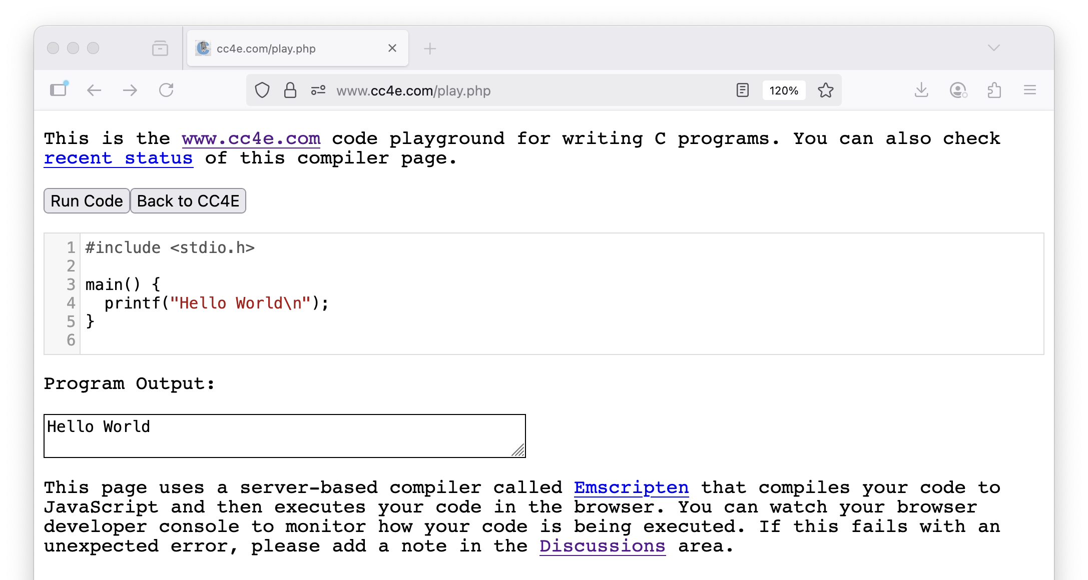

Slide 95
Summary
Fetch-Decode-Execute (a.k.a. Fetch-Execute-Cycle)
Look at the Intel x86 and ARM processor families
Explored the CDC8512 architecture, instruction set, assembly and machine languages
Explored an increasing use of in-browser emulators for games and other applications
Looked at CPU Evolution over time
Looked back at the Intel 4004
Looked forward at Web Assembly (WASM)

Slide 96
Acknowledgements / Contributions
These slides are Copyright 2025- Charles R. Severance (online.dr-chuck.com) as part of www.ca4e.com and made available under a Creative Commons Attribution 4.0 License. Please maintain this last slide in all copies of the document to comply with the attribution requirements of the license. If you make a change, feel free to add your name and organization to the list of contributors on this page as you republish the materials.
Initial Development: Charles Severance, University of Michigan School of Information
Insert new Contributors and Translators here including names and dates
Continue new Contributors and Translators here

